Slide 1
Weekly report: Grid Code Development
Week number: 4
Date: 21/10/2025
Supervisor: Prof. Ing. Saiju
Presented by: Josef Remberger / Vijay Simha Reddy Bogala

Slide 2
List of contents
Milestones
Reactive Power / voltage control
Active Power / frequency control
Simulink simulation

Slide 3
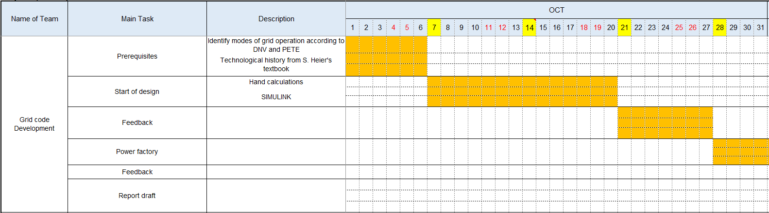
1. Milestones

Slide 4
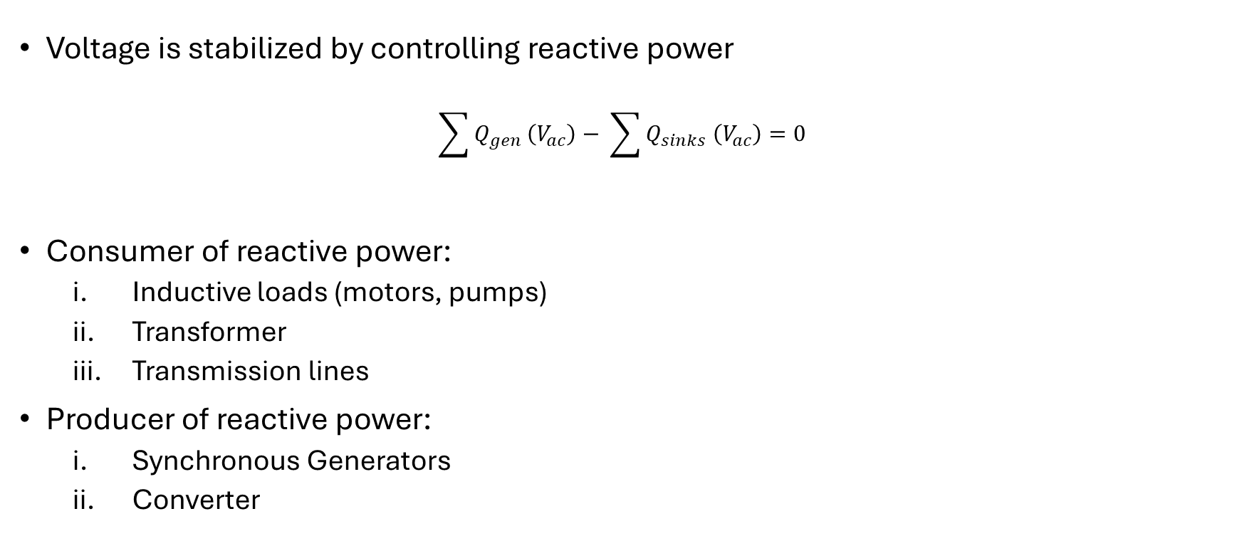
2. Reactive Power / voltage control
Voltage is stabilized by controlling reactive power
$$\sum{Q_{gen}}\left(V_{ac}\right)− \sum{Q_{sinks} \left(V_{ac}\right)=0}$$
Consumer of reactive power:
Inductive loads (motors, pumps)
Transformer
Transmission lines
Producer of reactive power:
Synchronous Generators
Converter
[1]

Slide 5
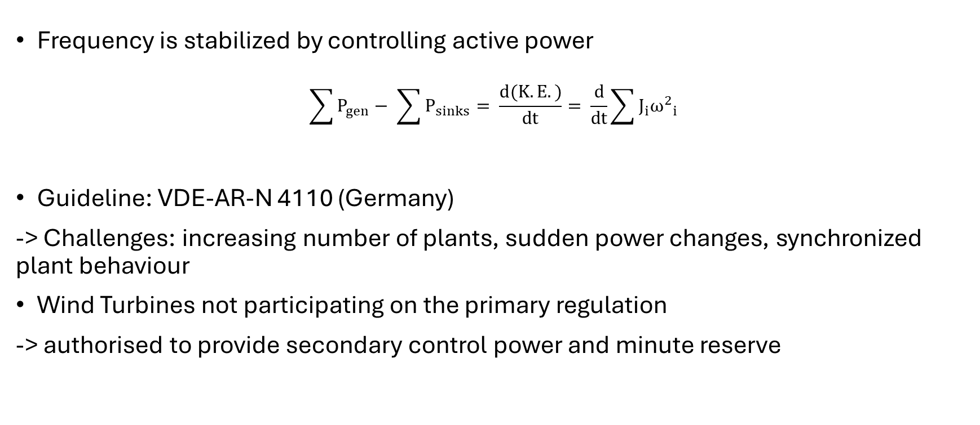
2. Active Power / frequency control
Frequency is stabilized by controlling active power
$$\sum{P_{gen}− \sum{P_{sinks}= \frac{d(K.E.)}{dt}= \frac{d}{dt}\sum{J_{i}{ω^{2}}_{i}}}}$$
Guideline: VDE-AR-N 4110 (Germany)
-> Challenges: increasing number of plants, sudden power changes, synchronized plant behaviour
Wind Turbines not participating on the primary regulation
-> authorised to provide secondary control power and minute reserve
[1], [2], [3]

Slide 6
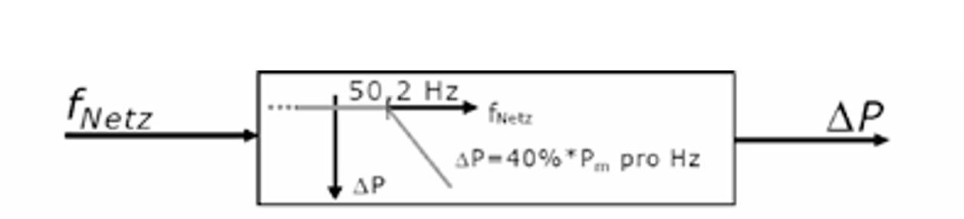
2. Active Power / frequency control
Normal operation f = 49.8-50.2 Hz
Over-frequency
Under-frequency
-> for WT increase of P only when wind > 50 % P_{N}
$∆P=20 P_{N}\frac{50.2 Hz −f_{grid}}{50 Hz}$ for 50.2 Hz < $f_{grid }$< 51.5 Hz
$∆P=P_{N}\frac{\left(49.8 −f_{grid}\right)∗100}{50 Hz ∗ s}$ for 47.5 Hz < $f_{grid }$< 49.8 Hz s=2%
[2], [3]

Slide 7
3. Simulink simulation
Based on the “Wind Farm - Doubly-Fed Induction Generator (DFIG) Average Model” in MATLAB​
Simulation Setup: 20 x 5 MW DFIG
Simulation Target: Grid support with active/reactive power

Slide 8
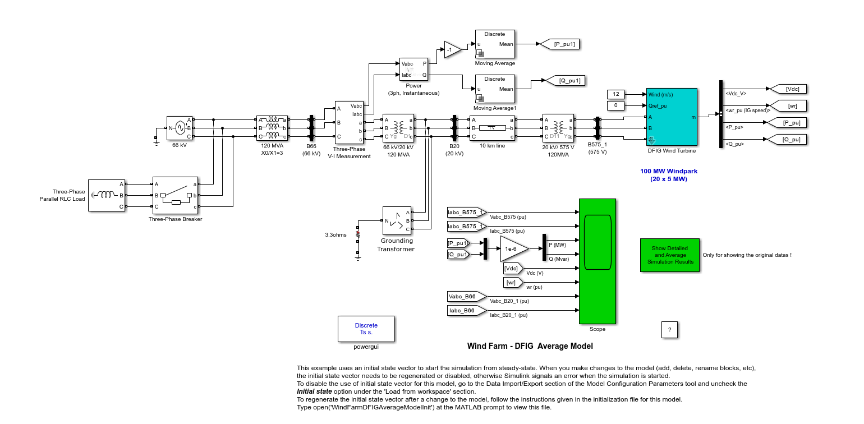
3. Simulink simulation

Slide 9
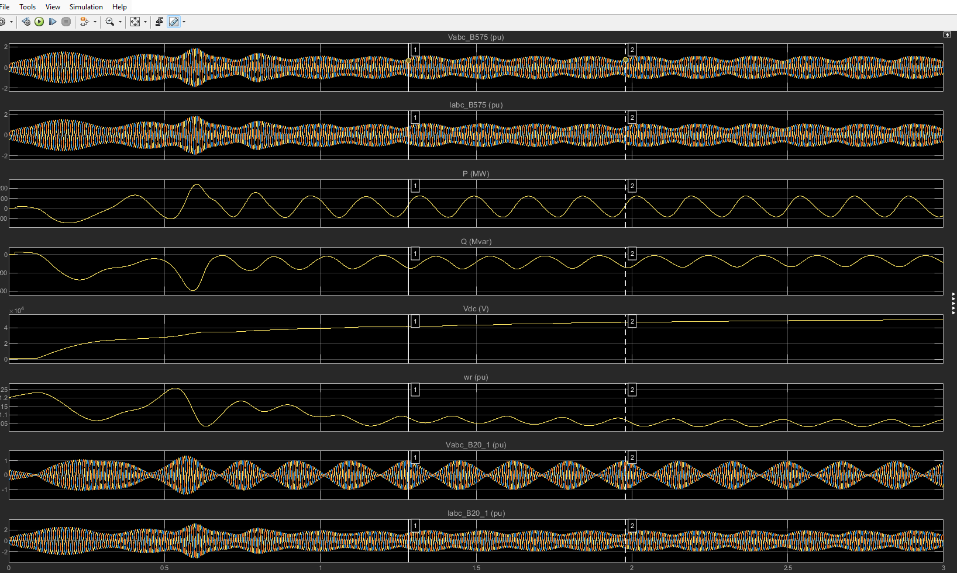
3. Simulink simulation

Slide 10
Bibliography – Grid Code Development
[1] “Hybrid Power System Modelling-Simulation and Energy Management Unit Development”, R.Saiju 2008. (accessed Oct. 19, 2025)
[2] “Summary of the draft VDE-AR-N 4110:2017-02” VDE, 2017. https://eepublicdownloads.entsoe.eu/clean-documents/cnc-active-library/Germany/summary-draft-4110-en.pdf (accessed Oct.17, 2025)
[3] “Windkraftanlagen - Systemauslegung, Netzintegration und Regelung”, S.Heier 2022. (accessed Oct.17, 2025)

